Slide 1
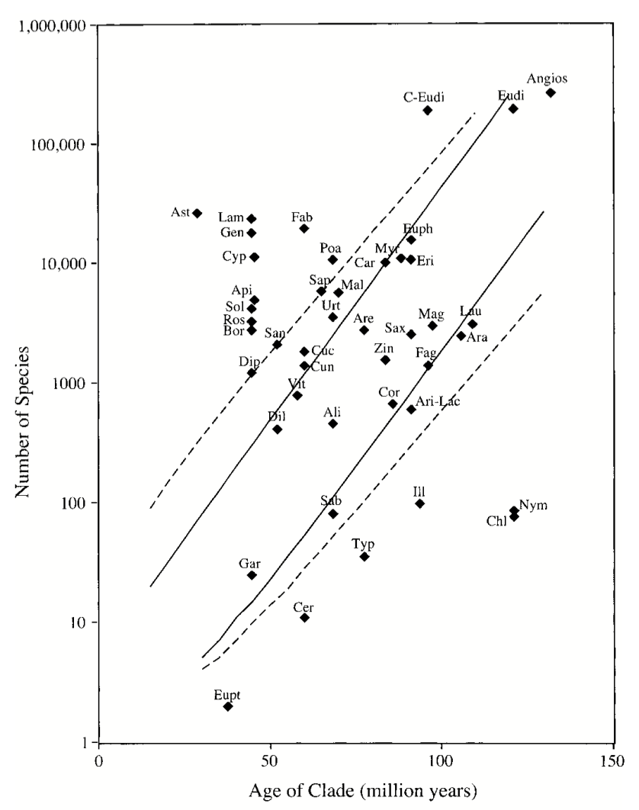
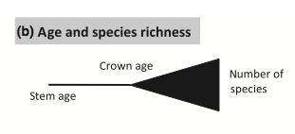
Magallon and Sanderson 2001. Clade age (crown group) vs. diversity

Slide 2
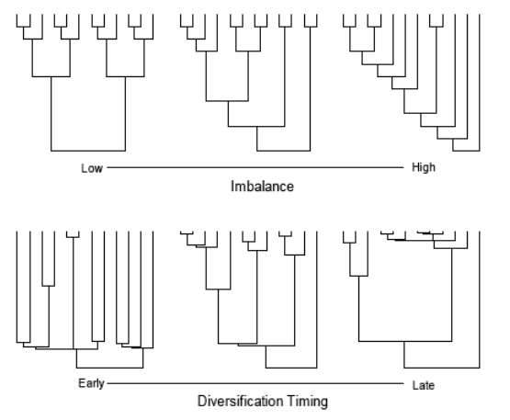

Slide 3
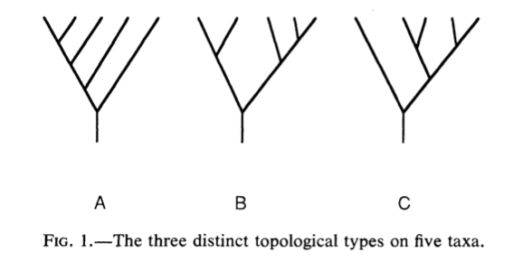
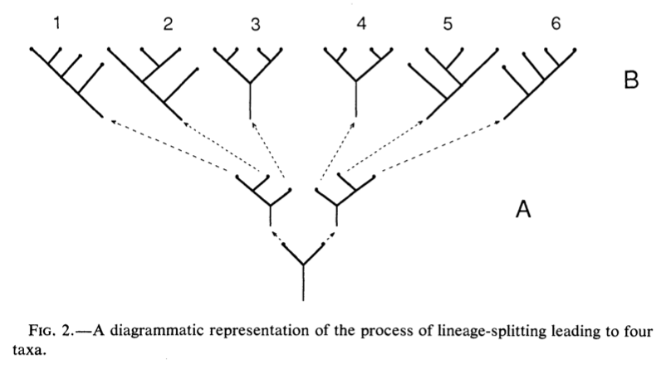
Slowinski and Guyer 1989 Am Nat

Slide 4
Morlon 2014 Ecology Letters

Slide 5
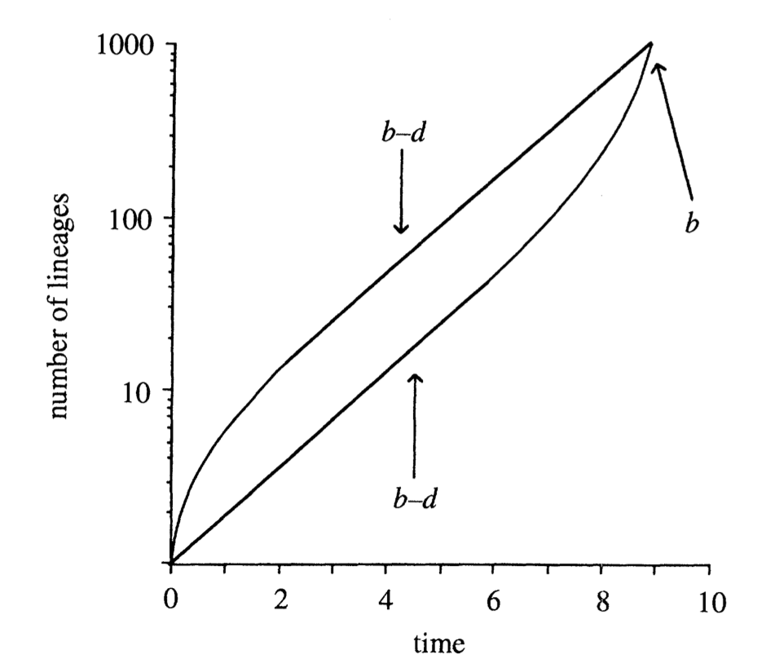
Actual (top) and reconstructed (bottom) LTT diverge in the presence of extinction
Nee et al. 2004

Slide 6
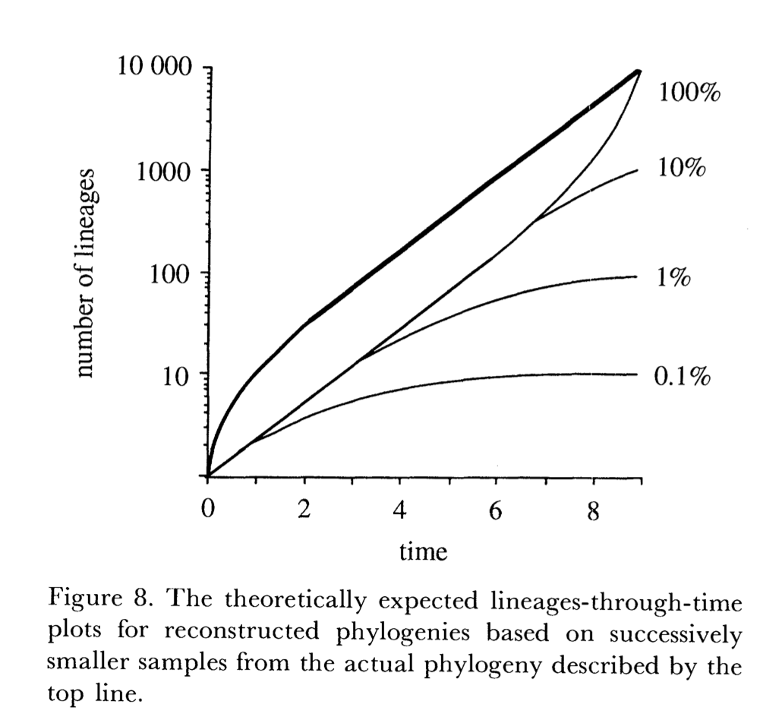
Nee et al. 2004

Slide 7
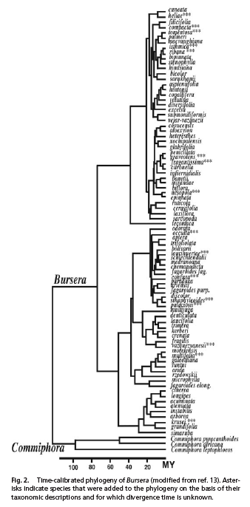
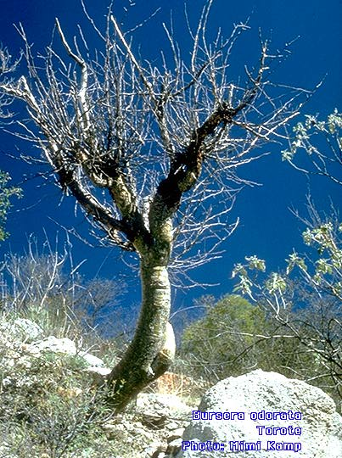
Becerra
Becerra 2005 PNAS

Slide 8
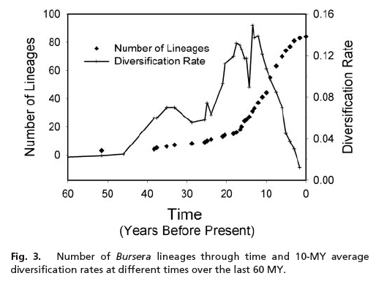
Becerra LTT
Lineages-through-time (LTT) plot
Becerra 2005 PNAS

Slide 9
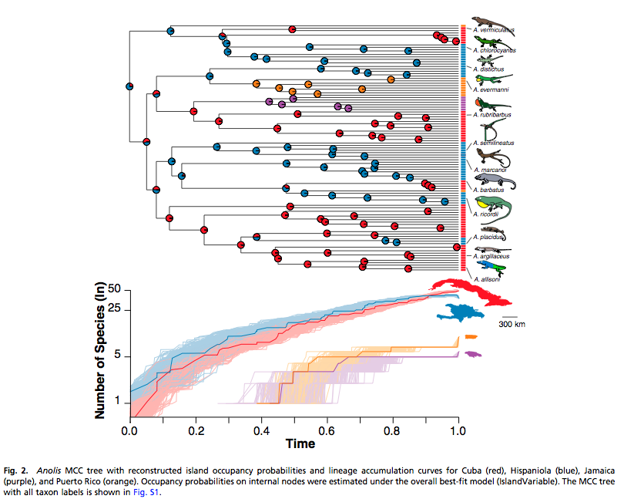
Rabosky and Glor 2010 PNAS

Slide 10
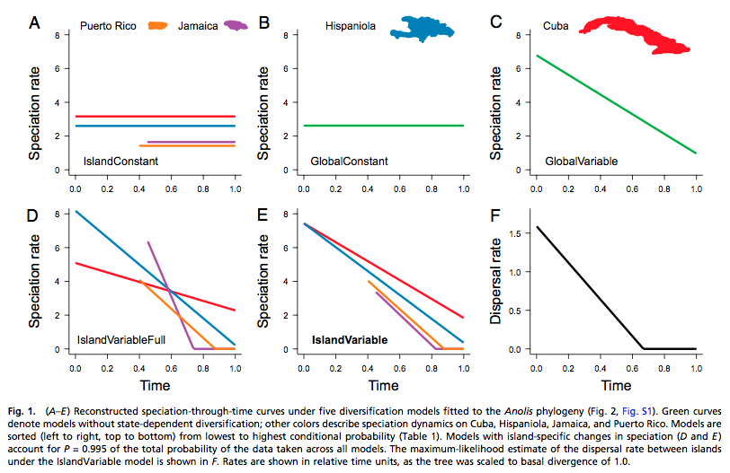
Rabosky and Glor 2010 PNAS

Slide 11
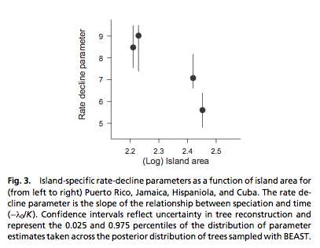
Rabosky and Glor 2010 PNAS

Slide 12
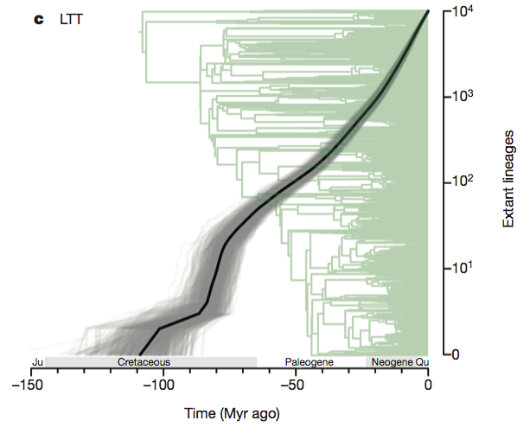
Jetz et al. 2012 Nature

Slide 13
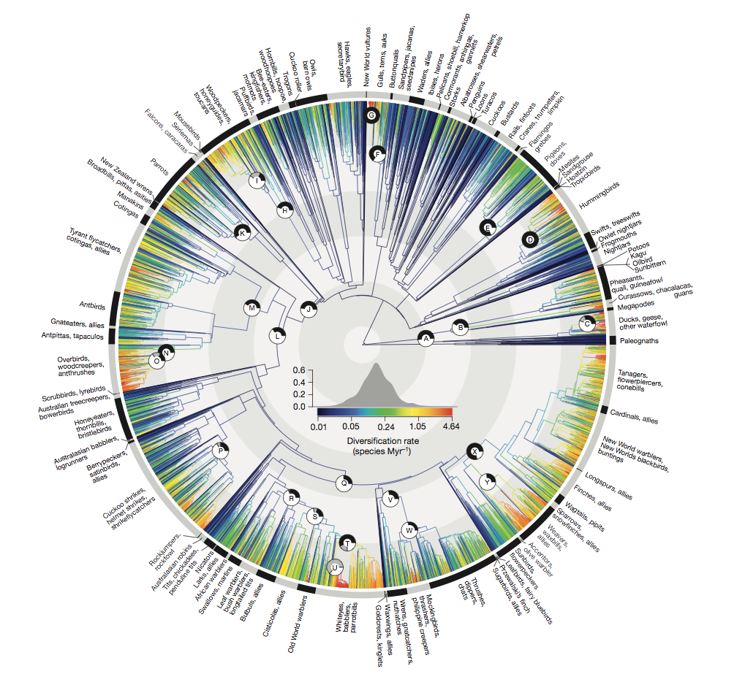
Jetz et al. 2012 Nature

